Slide 1

Kickstarting your Career in the Cloud
bit.ly/CareerReadinessOverview

Slide 2
A cloud-first world
By 2020, “cloud shift” will affect more than $1 trillion in IT spending.
- Gartner
Business demands for agility and innovation prompt rise of cloud native applications: adoption is set to double by 2020.
- Capgemini
Notes:
Leading industry research indicates that a shift to cloud will affect more than $1 trillion in IT spending. Adoption of cloud-native applications will double by 2020.

Slide 3

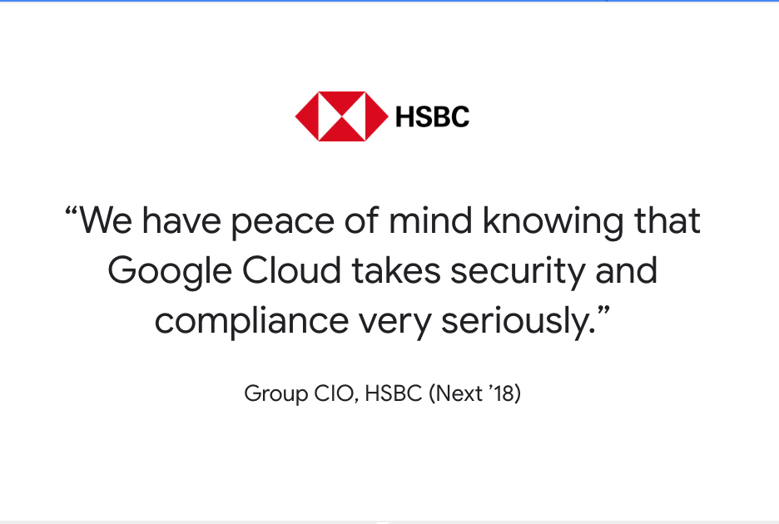
Customers value Google Cloud
https://cloud.google.com/customers
Notes:
Customers are leveraging Google Cloud to enable their digital transformations and migration to the cloud.
You can see details about Google Cloud customer stories from customers belonging to different industry verticals and regions at the url shown: cloud.google.com/customers.

Slide 4
Industry analysts recognize Google Cloud as a leader

Slide 5
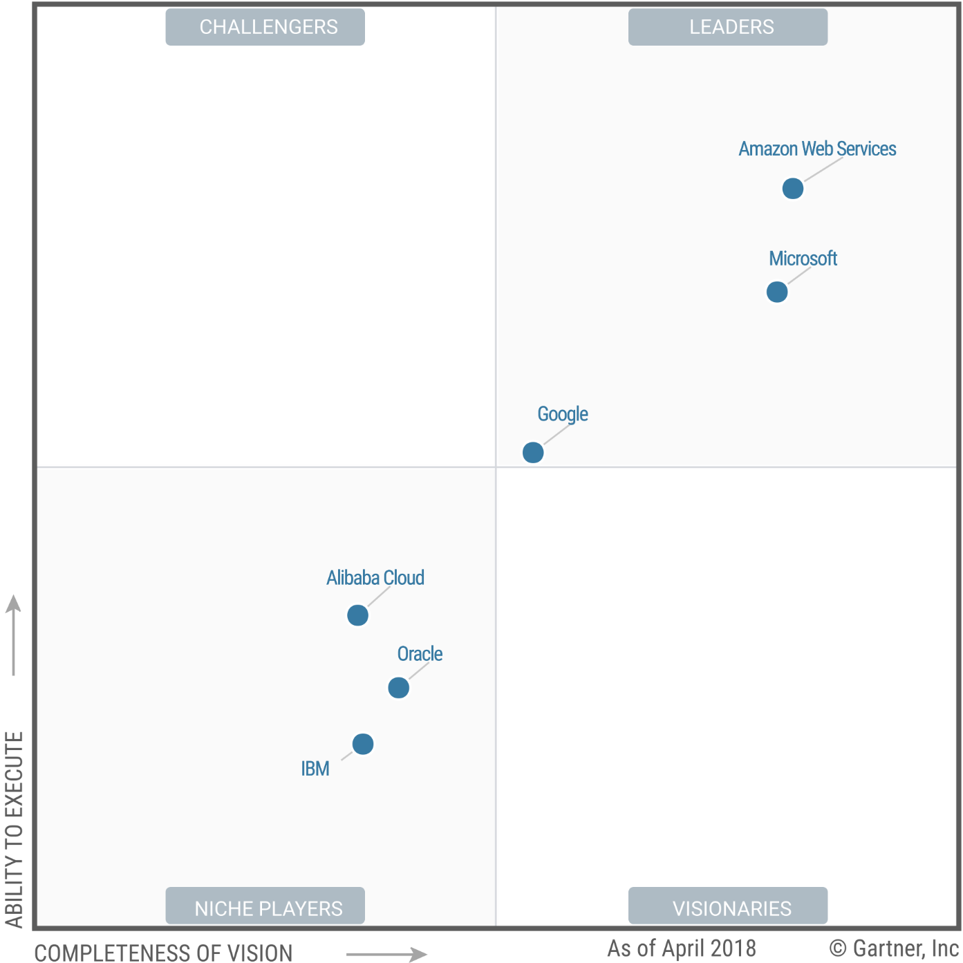
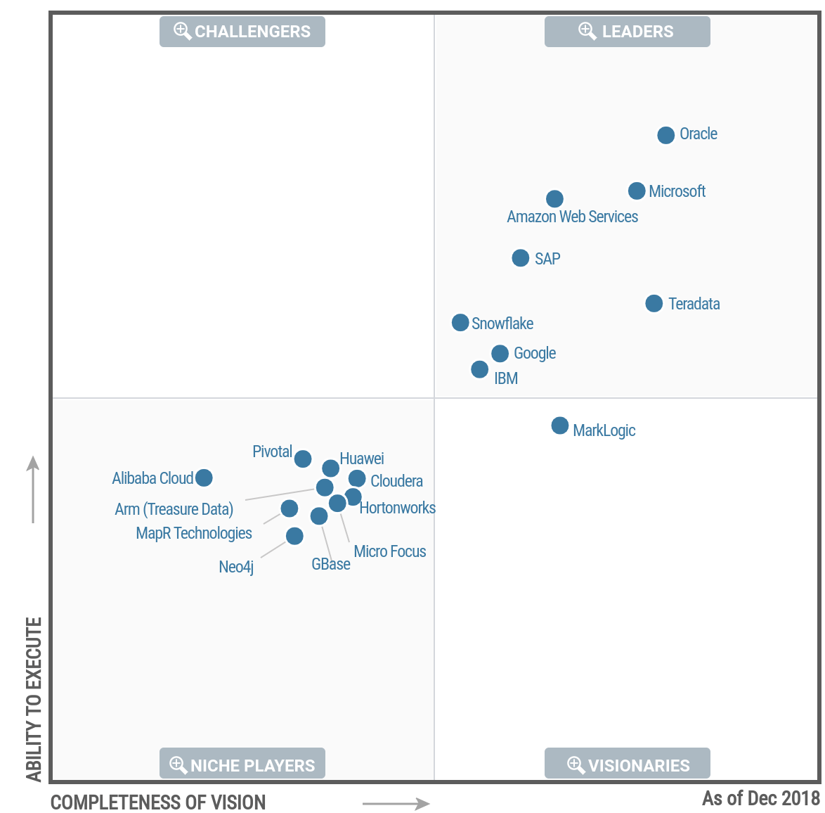
Gartner Magic Quadrant: “The Leaders Quadrant”
Cloud Infrastructure as a Service, Worldwide - May 2018
Data Management Solutions for Analytics (DMSA) - Jan 2019
Notes:
Google Cloud has been placed in the leaders quadrant by Gartner in 2018.

Slide 6
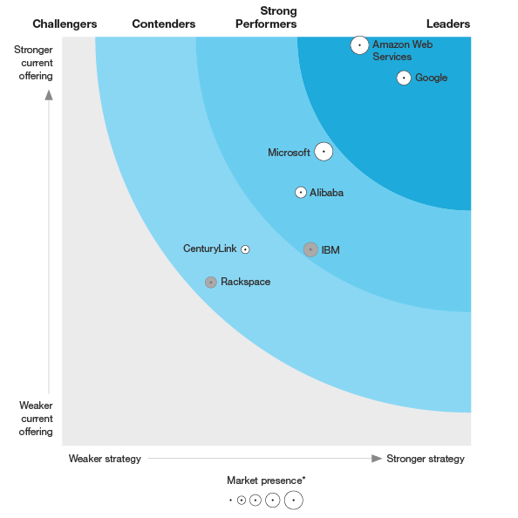
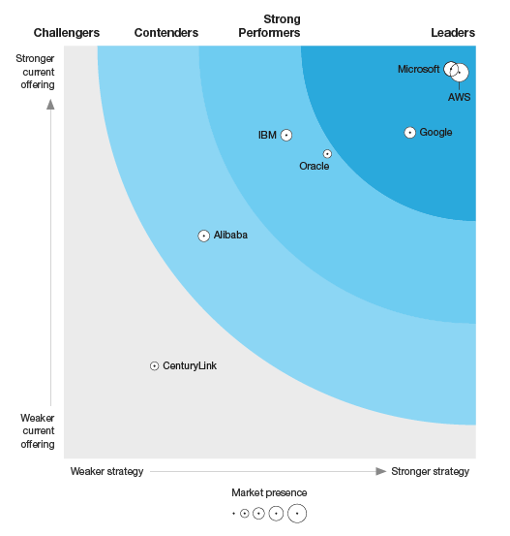
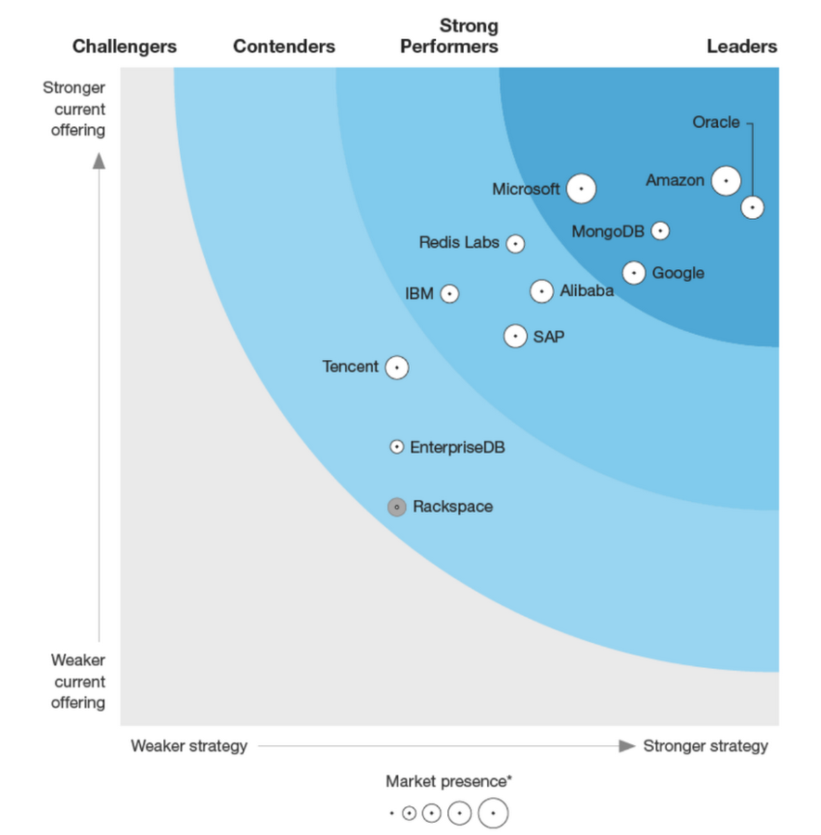
Forrester recognizes Google Cloud as a leader
The Forrester Wave™:
Public Cloud Platform Native Security - Q2 2018
The Forrester Wave™: Full-Stack Public Cloud Development Platforms North America - Q2 2018
The Forrester Wave™: Database-as-a-Service - Q2 2019
Notes:
Forrester recognizes Google Cloud as a leader in multiple categories - Public Cloud Platform Native Security, Full-Stack Public Cloud Development Platforms, Database-as-a-Service.

Slide 7
University education provides a strong theoretical foundation ...

Slide 8
You’ll need strong industry skills to launch your careers

Slide 9
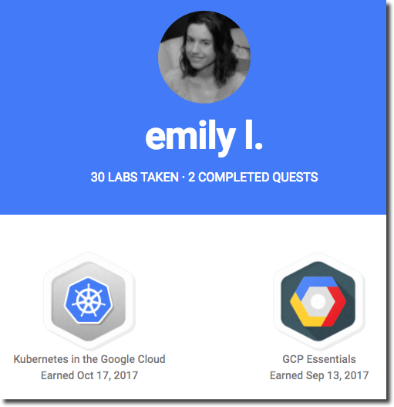
Begin your journey to cloud
Cloud Study Jams
Get your Qwiklabs quest badge to unlock deeper learning benefits!
Notes:
Begin your journey to cloud with Cloud Study Jams.
Cloud Study Jams give you an introduction to Google Cloud. Make sure to complete all labs in the Qwiklabs quest and get your badge. Badges unlock deeper learning benefits.

Slide 10
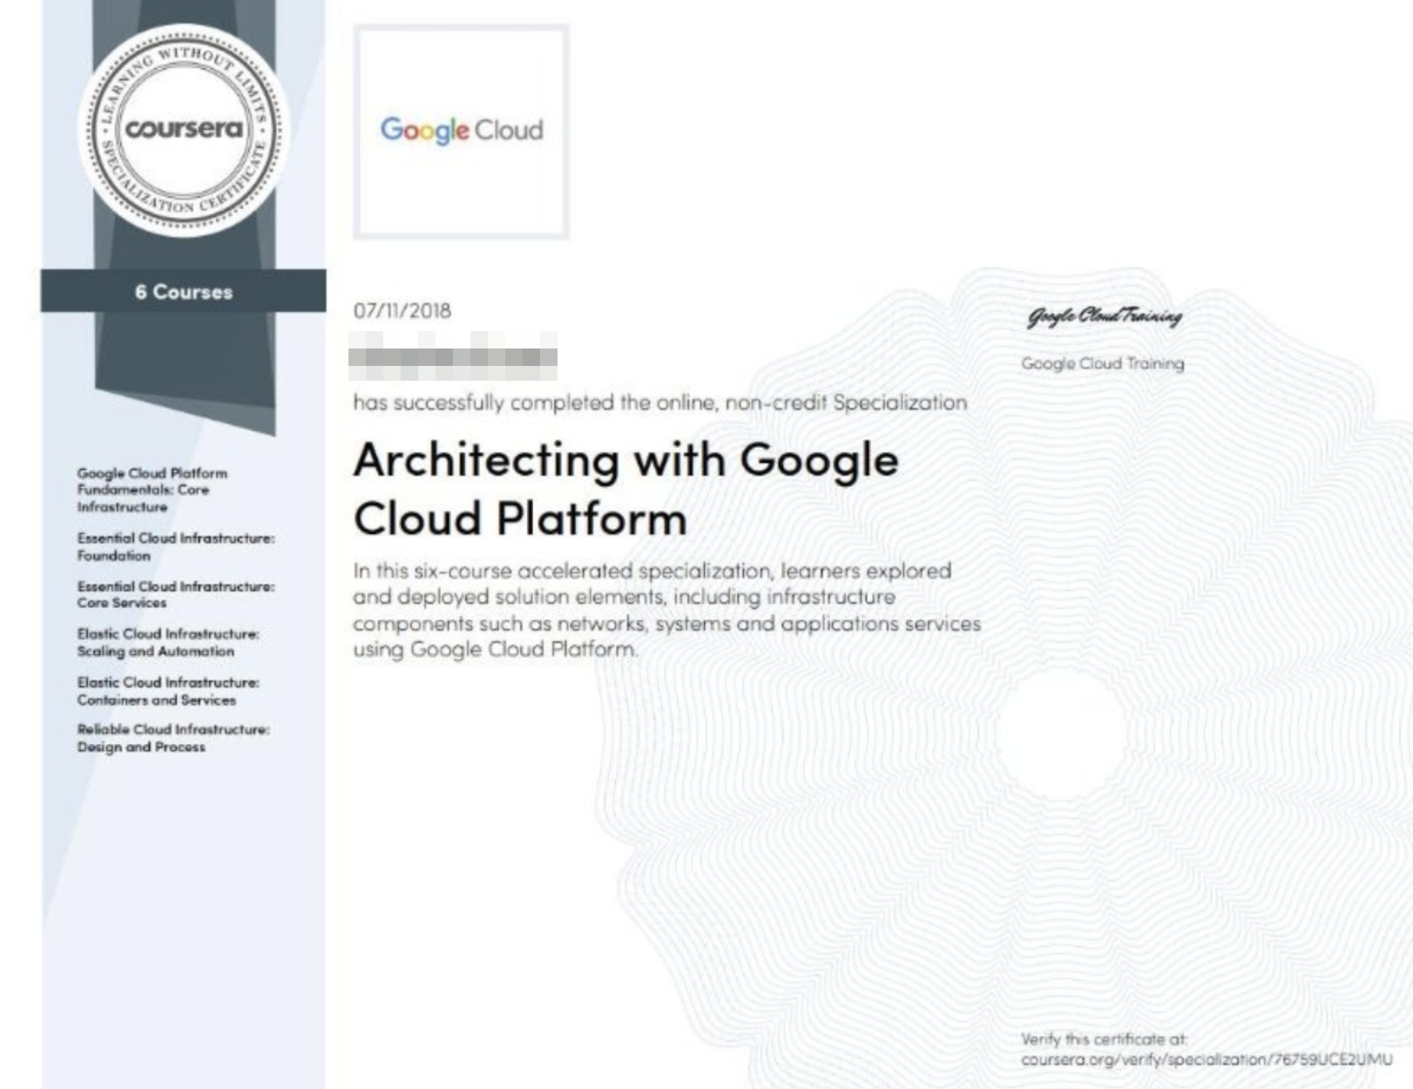
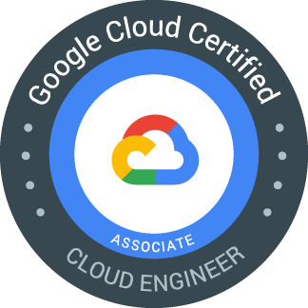
Build your cloud muscle
Cloud Study Jams
Career Readiness
Deep dive with in-depth training on Coursera and Qwiklabs
Notes:
You can then go on to build your cloud muscle with the Google Cloud career readiness program. Deep dive with in-depth training on Coursera and Qwiklabs. Upon successful completion of the training, you will receive a course completion certificate from Google Cloud and Coursera.

Slide 11

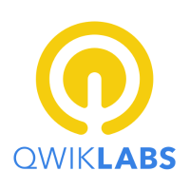
Career Readiness: Associate Cloud Engineer Track
On-demand
Get free access to “Architecting with Google Cloud Platform” specialization on-demand on Coursera.
(100% discount: 6 courses)
Self-paced labs
Get free access to “Cloud Engineering Quest” and additional self-paced labs on Qwiklabs.
(100% discount: 10+ labs)
Prepare for careers in a cloud-first world. Ask your faculty or career services head to apply.
g.co/edu/cloudready
Google Cloud Certified
Prepare to take the exam and earn your Associate Cloud Engineer Certification.
(100% discount for faculty, 50% discount for students per adherence to timelines and other criteria)
Notes:
You can now kickstart your career in cloud-related career paths. Google’s leading edge, enterprise-ready curriculum and learning resources can help you achieve industry-recognized Associate Cloud Engineer certification!
The Associate Cloud Engineer track provides training free of charge to prepare for the Associate Cloud Engineer certification exam.
The track includes access to the Architecting with Google Cloud Platform specialization on Coursera. This on-demand training includes 6 in-depth courses with videos, hands-on labs, and quizzes.
Hands-on experience is crucial for success with the Associate Cloud Engineer certification exam. You will receive credits to complete self-paced labs on the Qwiklabs platform free of charge.
This training puts you on the path to success for achieving the Associate Cloud Engineer certification.
Based on course completion timelines and other criteria, students receive a 50% discount on certification exam. If you choose to appear for the certification exam and pass the exam, you will be a Google Cloud Certified Associate Cloud Engineer.

Slide 12
Leverage cloud skills to launch your startup or land your first job!
Competitions
Cloud Study Jams
Career Readiness
Internship
Your first job!
Notes:
With Cloud Study Jams and the Career Readiness program, your learning journey with Google Cloud sets you up strongly for competitions, an internship, or your first job!

Slide 13
Training and certification differentiate you from the rest of the candidate pool
In an independent study of users certified for at least 6 months, recipients of Google Cloud Certifications provided positive feedback about the impact of their certification:
Get visibility
with employers
80% of those who applied for a new job received at least one job offer
Complete training on Coursera for an opportunity to share your information directly with Google and other hiring partners.
1 in 3 certified users received a raise or acquired a job for higher pay
70% say Google Cloud Certification
helped them to grow in their job
Your institution can apply now: g.co/edu/cloudready
Notes:
Google Cloud training and certification differentiate you from the rest of the candidate pool.
When you complete a specialization on Coursera, you have the opportunity to share your information directly with Google and other hiring partners.
Certification gives you tangible benefits as well. 80% of those who applied for a new job received at least one job offer. 1 in 3 certified users received a raise or acquired a job for higher pay.
Your institution can apply now at g.co/edu/cloudready.

